Slide 1

DEPARTMENT OF ARTIFICIAL INTELLIGENCE AND DATA SCIENCE
Artificial Neural Networks and Deep Learning: 21ADG64
LA1 - Seminar
“Image Captioning”
Presented By
N Suhaas Suran
[1NT21AD034]
Name of the Course Instructor Dr Meenakshi

Slide 2

CONTENTS
Introduction and Motivation
Methodology and Approach
Results and Analysis
Conclusion and Future Recommendations
Demo video of code
Github link of PPT and Code
References

Slide 3
INTRODUCTION AND MOTIVATION
Image captioning is the process of automatically generating textual descriptions or captions for images using machine learning and deep learning techniques.
Typically, features are extracted from the image using computer vision models like Convolutional Neural Networks (CNNs), while natural language processing models like Recurrent Neural Networks (RNNs) or Transformers are used to generate the caption.
The objective is to help computers understand and describe images in a way similar to how humans perceive visual information. Our project aims to develop a system that can automatically produce descriptive captions for images.

Slide 4
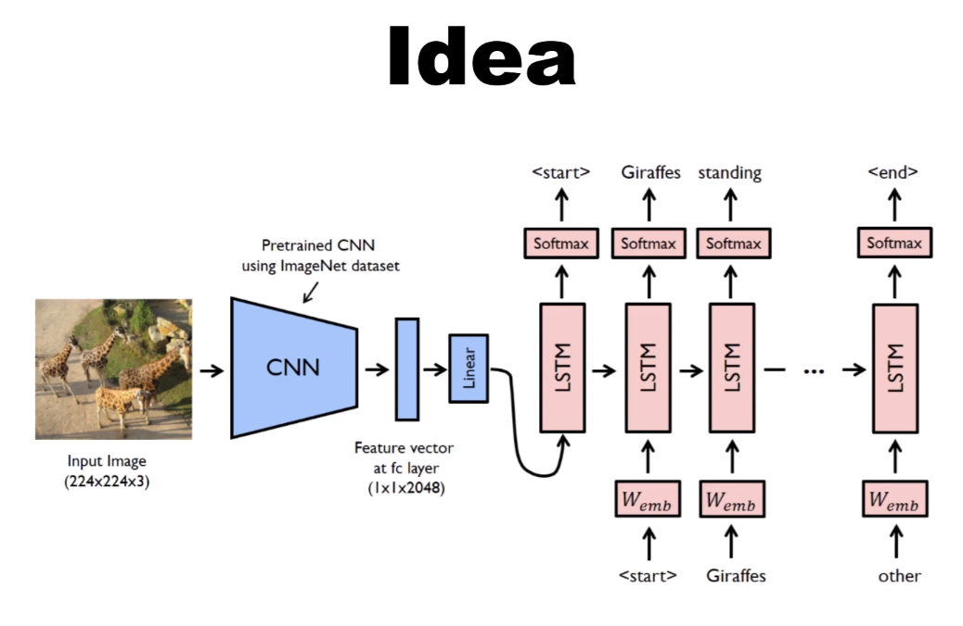
METHODOLOGY AND APPROACH
Loading and pre-processing the Flickr8k dataset, which includes images and corresponding captions.
Using a pre-trained VGG16 model to extract features from images. The model is restructured to remove the final classification layer, leaving a feature extraction model.
Processing captions by cleaning text and adding start and end tokens to mark the beginning and end of each caption.
Tokenizing captions to convert words into numerical tokens for model input.
Splitting the dataset into training and testing sets.
Building and training an image captioning model using an encoder-decoder architecture. The encoder processes image features, and the decoder generates captions using LSTM cells.

Slide 5
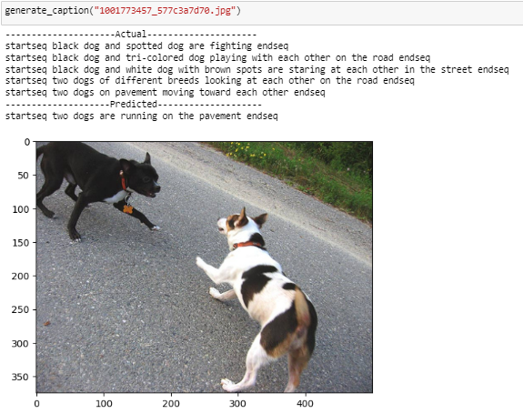
RESULT AND ANALYSIS
The model is trained using the training set, and its performance is evaluated using the testing set. The evaluation includes calculating the BLEU-1 and BLEU-2 scores, which measure the similarity between predicted and actual captions.
Actual Output
Predicted Output

Slide 6
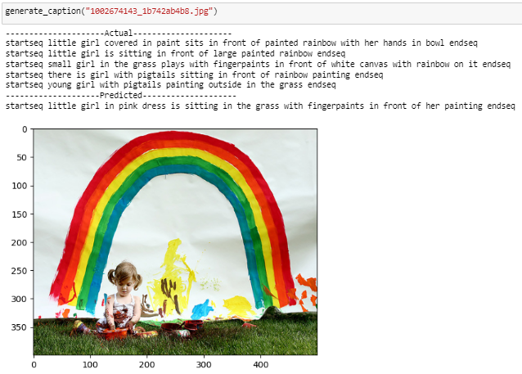
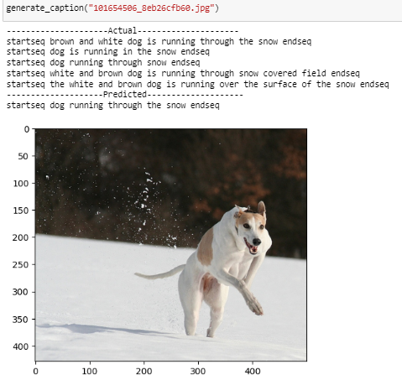
RESULT AND ANALYSIS
BLEU-1: 0.534413
BLEU-2: 0.307770
The results show that the model is capable of generating captions for images, with the BLEU scores providing a quantitative measure of its performance.

Slide 7
CONCLUSION AND FUTURE RECOMMENDATIONS
In conclusion, this project has demonstrated the feasibility and effectiveness of using Convolutional Neural Networks (CNNs) for feature extraction and Long Short-Term Memory (LSTM) networks for text generation in the task of image captioning. By automatically generating descriptive captions for images, the system enhances accessibility and understanding for visually impaired individuals and others who may have difficulty interpreting images. The results achieved, with a BLEU-1 score of 0.534413 and BLEU-2 score of 0.307770, indicate the potential of the proposed approach in accurately describing image content.
Future recommendations include exploring more advanced models, such as transformer-based architectures, and incorporating attention mechanisms to improve the quality of generated captions further. Additionally, fine-tuning the model on larger datasets and exploring different pre-trained models for feature extraction could lead to performance improvements.

Slide 8
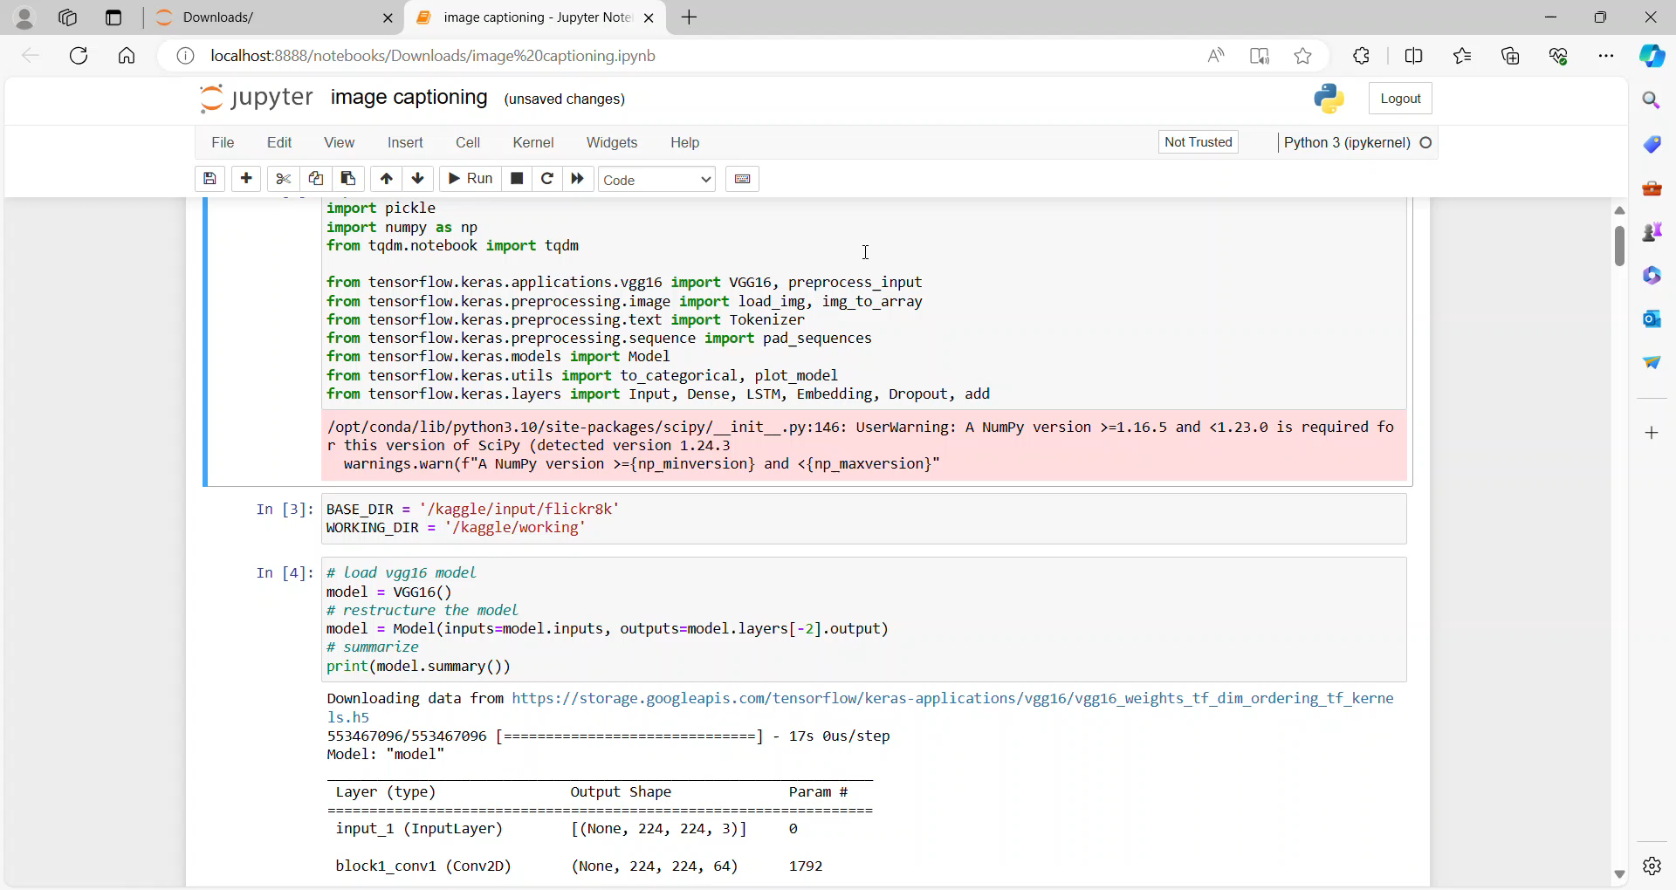
DEMO VIDEO OF CODE

Slide 9
GITHUB LINK
GitHub link: https://github.com/Suhaas-Suran/Image-Captioning
The above link contains:
README file
PPT
Code

Slide 10
REFERENCES
Flickr8k Dataset:
https://www.kaggle.com/datasets/adityajn105/flickr8k
VGG16 Model: https://www.tensorflow.org/api_docs/python/tf/keras/applications/VGG16
LSTM Model: https://www.tensorflow.org/api_docs/python/tf/keras/layers/LSTM
Show and Tell: A Neural Image Caption Generator
https://ieeexplore.ieee.org/document/7298935

